Slide 1
Individual Project: Game Analytics
Michael Rinaldi

Slide 2
My Project
Perform Game Analytics on my Group Project to increase session length and retention.
Analyze heatmap data to see where players are going and where they aren’t, and edit the level(s) to fix this.
Smooth the difficulty curve of the game.

Slide 3
Where to start
Had to start somewhere
First, the game was a level where you collect ‘powerups’ which are white spheres.
Your score increases by 1 for each sphere you get. There are 10 different locations for the spheres. They spawn in order and they loop after you get the last one.
The Goal: Get players to playtest the game to see which spheres are hard/easy to get, and to see how an improvement would change this.

Slide 4
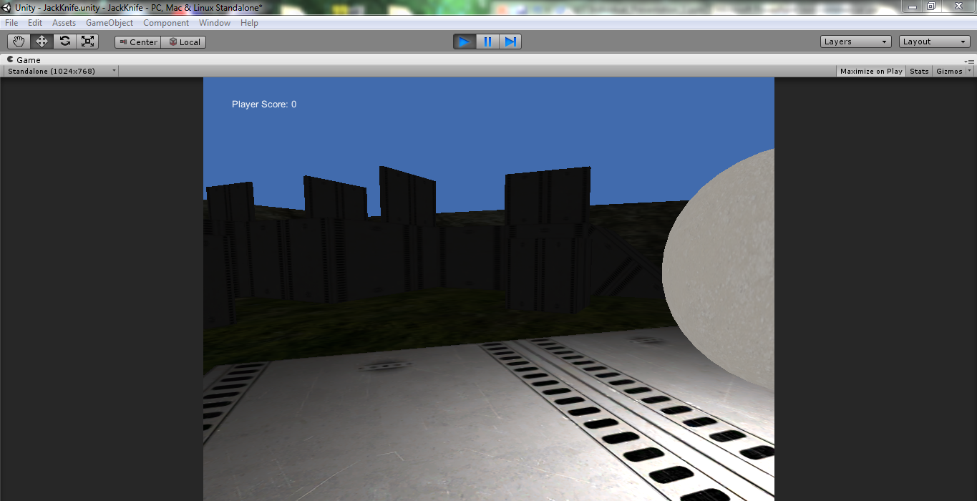
The Game: JackKnife
Whenever you shoot someone, you switch places with them.

Slide 5
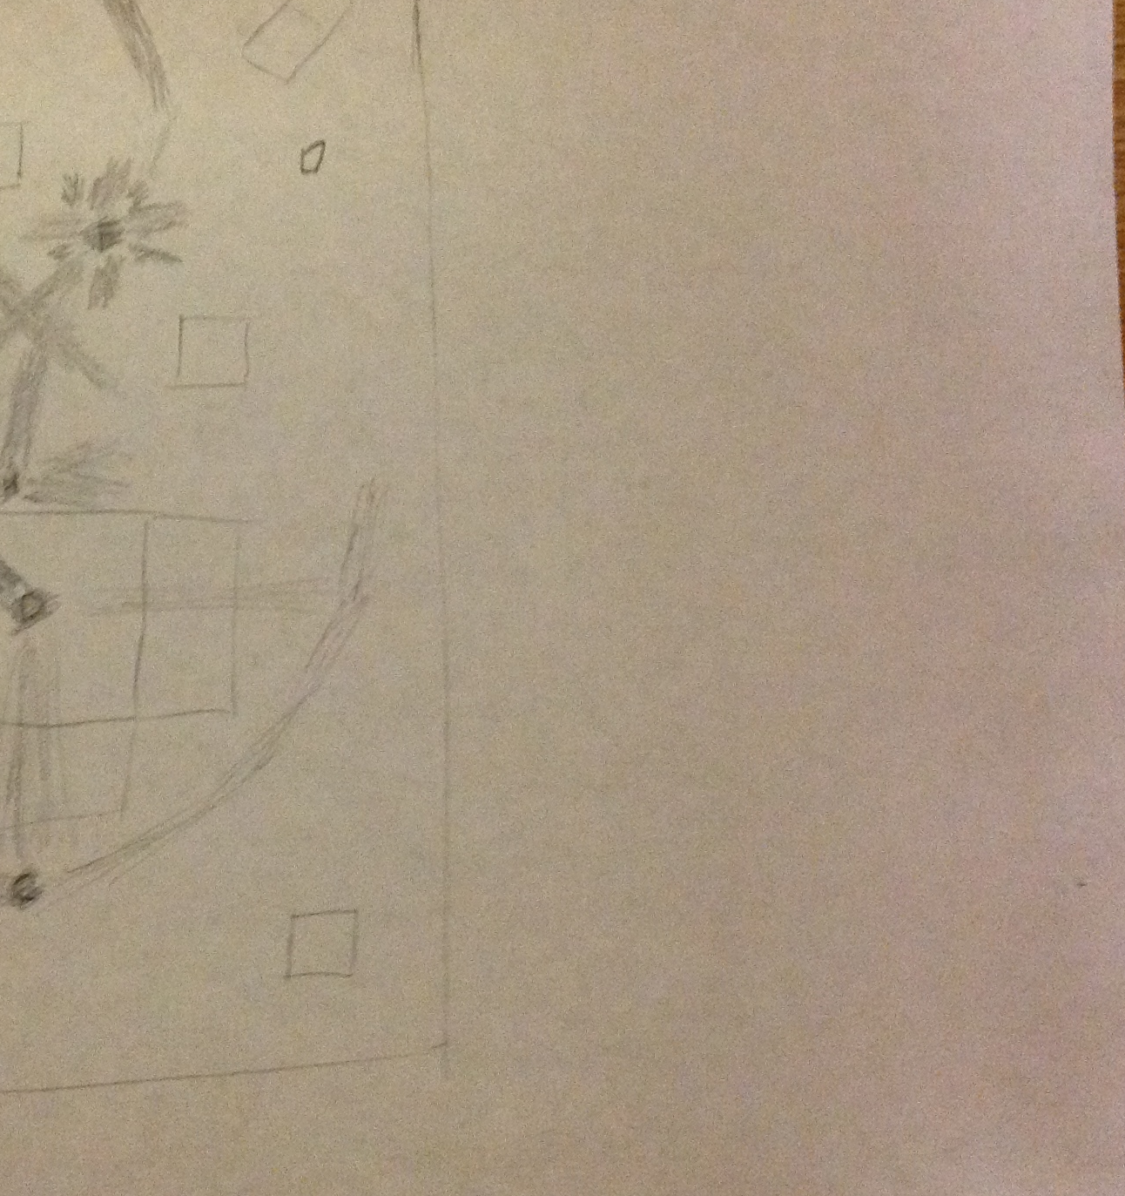
Prediction
Upside-down (that’s the orientation of the heatmap)
Player Start is the star
A-J are the spheres, in letter order.
Relative (marked points of highest concentration)

Slide 6
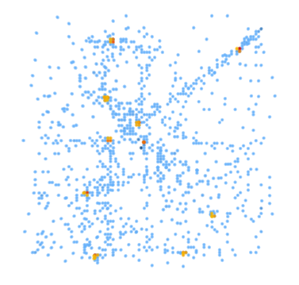
Heatmap Build 0.1
1024 Bread Crumb data points
Orange is collision enter
Blue is Bread Crumb (every second)
Prediction was correct in some aspects, and incorrect in others.

Slide 7
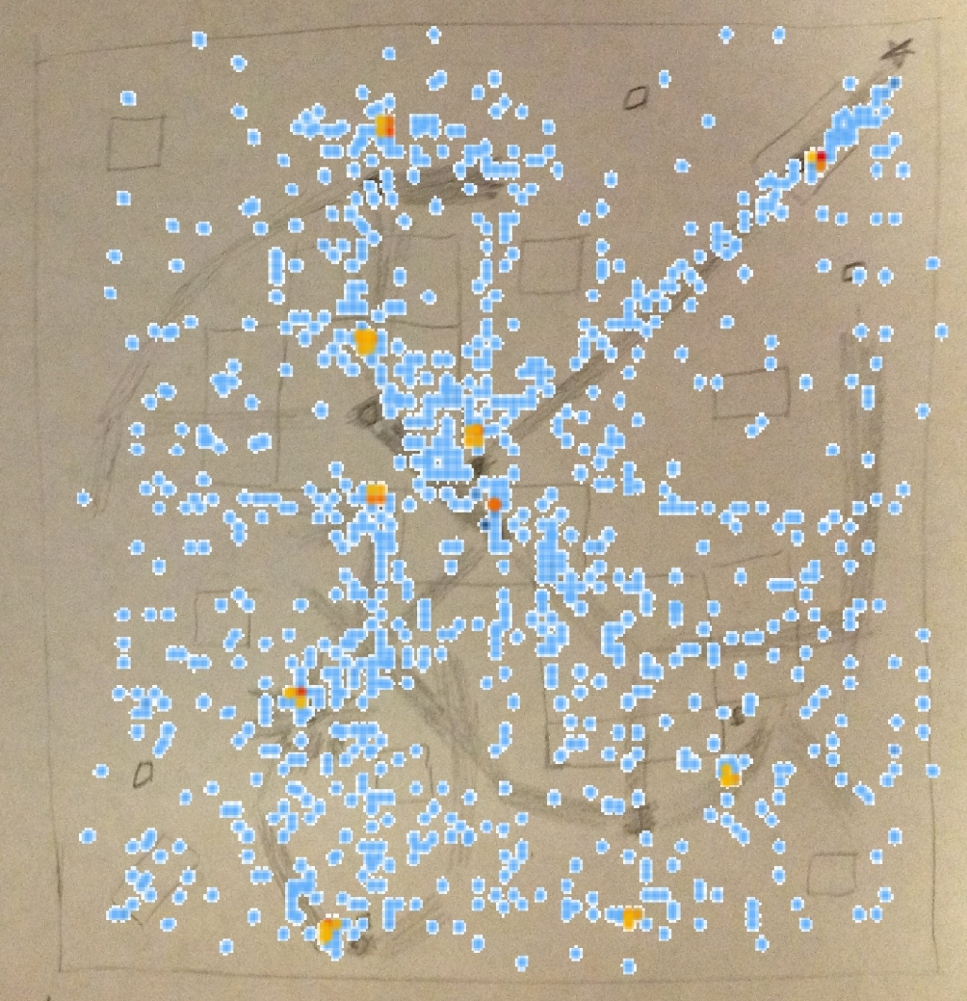
Overlay of Heatmap on prediction
Drawing is slightly unproportional.
Got general directions correct, did not account for wandering.

Slide 8
Where to go from here
Wanted to change something to see what effect it would have on the game
Decided to make the spheres glow with light so the player will have an easier time finding them.
Prediction: the paths will become more condensed and consistent. The spheres that were a problem earlier would become less of a problem.

Slide 9
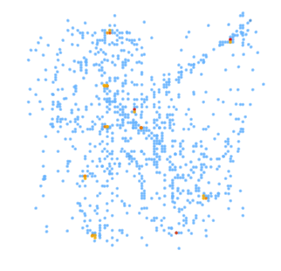
Heatmap Build 0.2
960 Bread Crumb data points
Orange is collision enter
Blue is Bread Crumb (every second)
The paths look like they became more condensed, but some spheres were still hard to find.

Slide 10
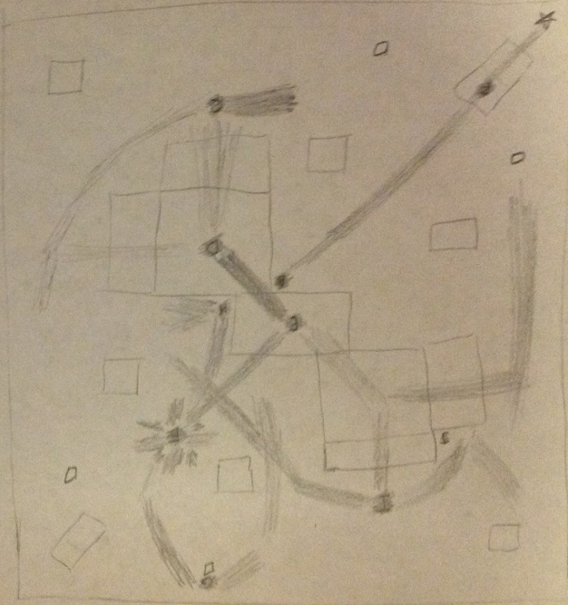
Comparison

Slide 11
What next?
We got a first build of JackKnife out.
There are 7 enemies that patrol on the level
They will shoot you if they see you (shooting sounds added).
You have a gun and a limited 10 ammo.
You switch places with an enemy when you shoot it.
Prediction:
The game seems too easy to me, especially with the center target in the middle.
Odds are the player will kill all of the enemies pretty fast, and restart often without dying.
Changes that we could make to stop this (if this happens) are:
to eliminate the aiming circle
make the enemies more intelligent and reactive
make the player have less aiming accuracy
make the enemies more accurate

Slide 12
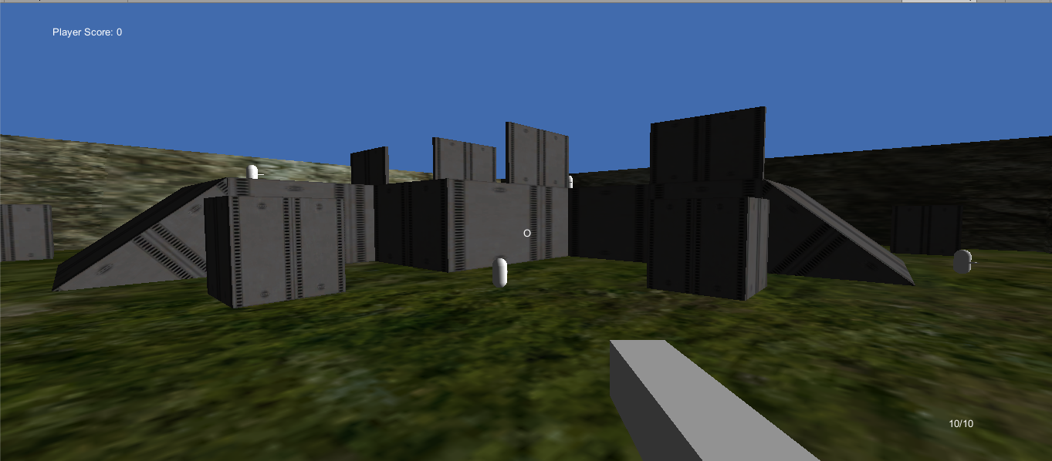
First Build
The view of the level from a ramp

Slide 13
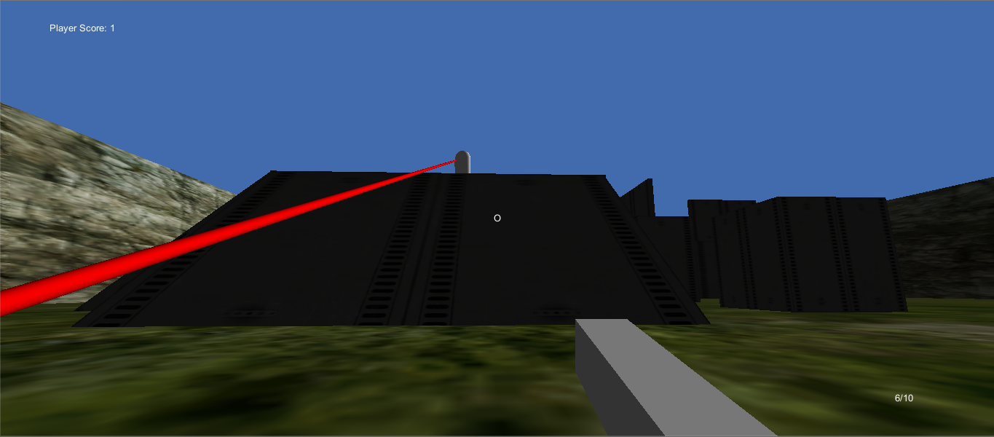
First Build
An enemy shooting at you and missing

Slide 14
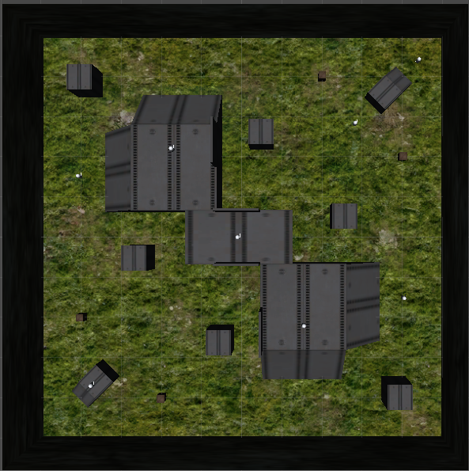
First Build
Top Down

Slide 15
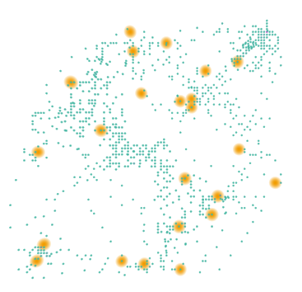
Heatmap Build .5
(.3 and .4 were used for testing, as to not skew the results)
942 Bread Crumb data points
Orange is Player Destroy
Blue is Player Bread Crumb (every second)
Player is dying at many different locations (which is good)
Movement is centered along the diagonals of the area.
Bottom left area is barren because no enemies are in that area

Slide 16
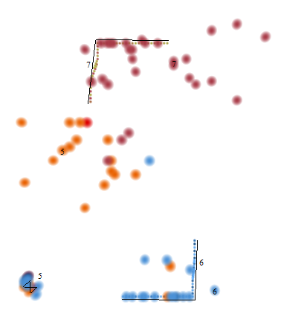
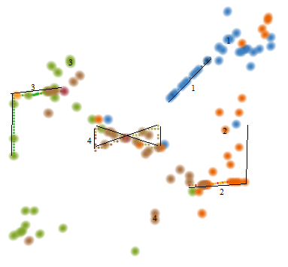
More Data (Enemy Heatmaps)
Enemies labeled 1-7
Tracked Enemy Bread Crumb (small dots, lines added for visuals) and Enemy Destroy (large dots)
Since you switch places when you die, Enemy Destroy is actually tracking where you kill them!

Slide 17
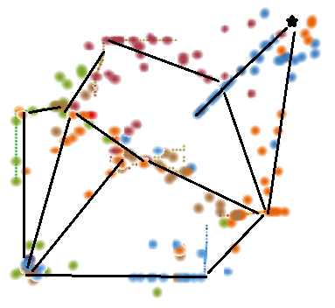
What to make of this
Estimating the player motion
Seeing where the player killed the enemies in relation to the enemies’ location implies movement in that direction
Seeing where the player concentrated his/her movement

Slide 18
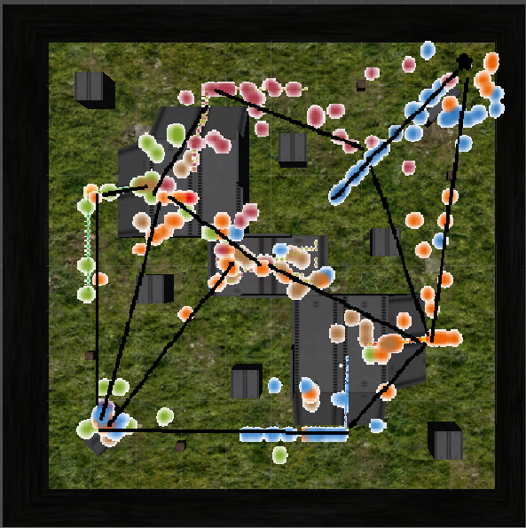
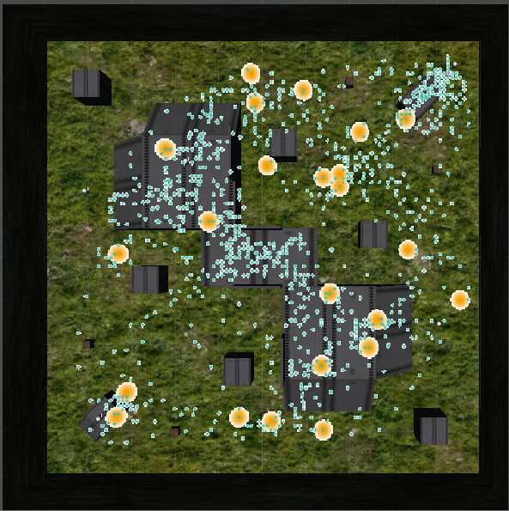
Overlay of Heatmaps on Level

Slide 19
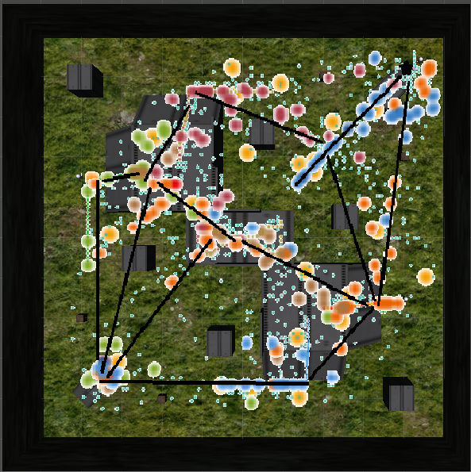
Overlay of Everything
Minimal player wandering, as there are less stray small blue dots.
Probably because of the open environment.

Slide 20
Playtesting
I noticed that some times, people ran out of ammo too quickly sometimes (if you missed 4 shots, you lost), and other times, people were very conservative with their ammo because it was limited.
Solution: In the new version of the game, we implemented melee attacks, so you don’t immediately lose when you run out of ammo. Instead, it becomes more difficult because you have to approach the enemy.
Other than that, I thought the difficulty curve was fine the way it was.

Slide 21
A New Level
Implemented a Maze-like level, to see how players would react to a non-open environment as opposed to the open environment in the first level.
Prediction:
Longer sessions because of more foot time and less switching places.
However, players might not be able to find all of the enemies.

Slide 22
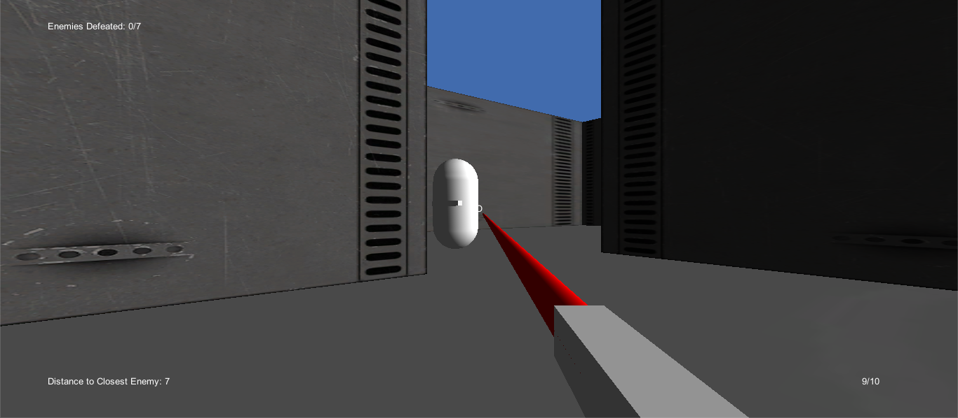
Level 2
Shooting (and missing) at an enemy

Slide 23
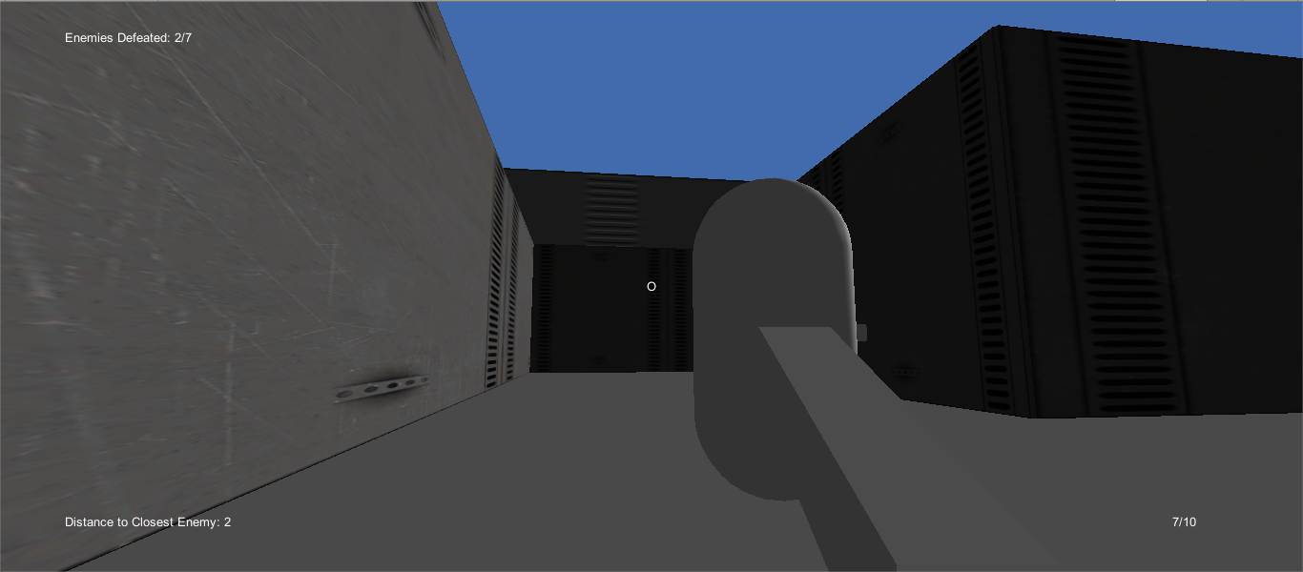
Level 2
Attempting a melee attack

Slide 24
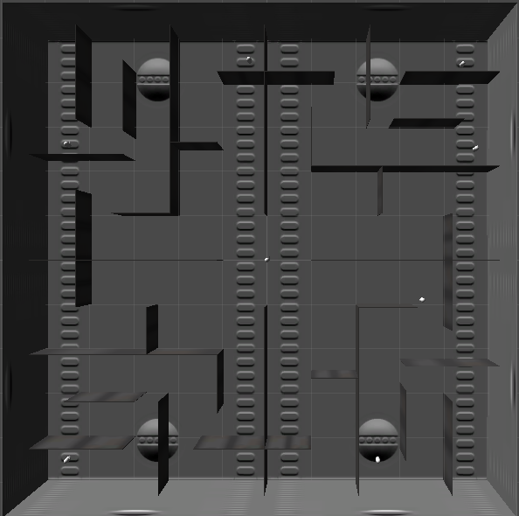
Level 2
Top Down

Slide 25
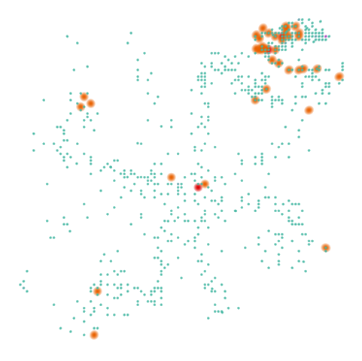
Heatmap Build .7
645 Bread Crumb data points
Orange is Player Destroy
Blue is Player Bread Crumb (every second)
Player is not dying in many different locations
Player is dying a lot to the first enemy at the top right (near the start point)
Movement is in a star pattern, with the center being the focal point
Barren areas contain no enemies

Slide 26
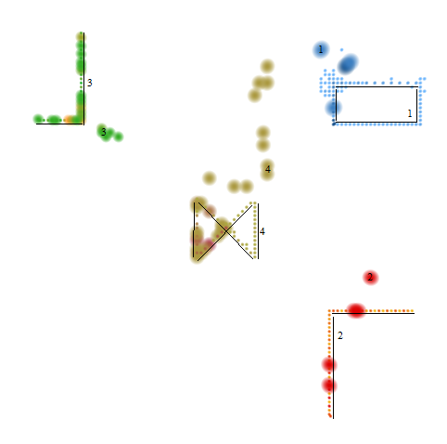
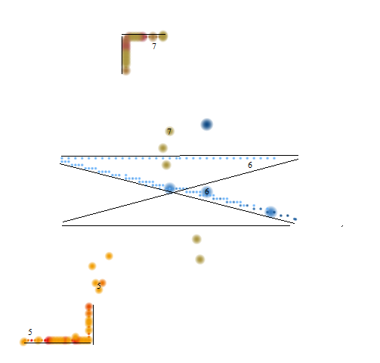
Enemy Heatmaps

Slide 27
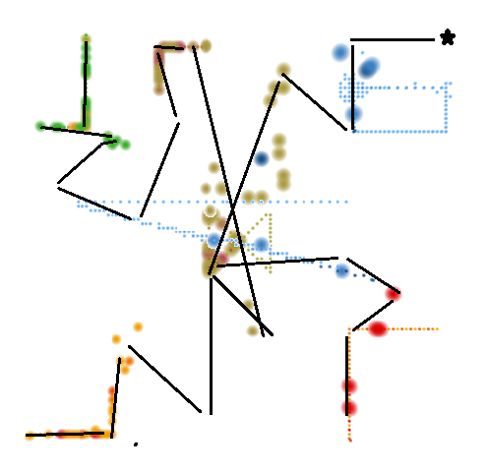
Predicting Player Motion

Slide 28
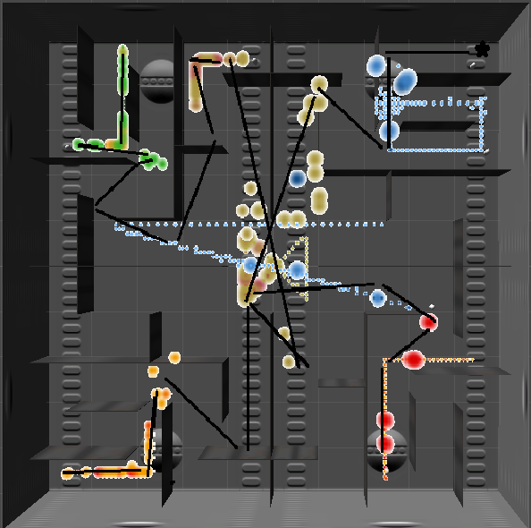
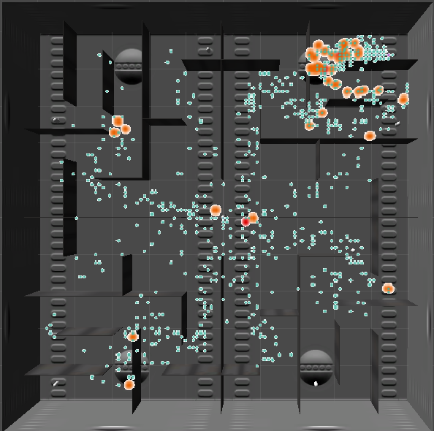
Overlay of Heatmaps on Level 2

Slide 29
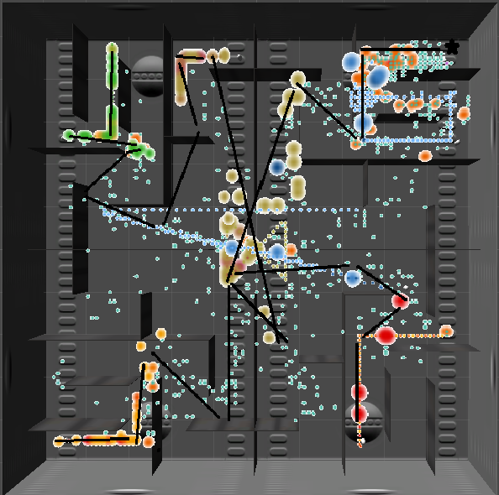
Overlay of Everything
Wandering is still happening a decent amount.
However, most of the player movement corresponds to the estimation.

Slide 30
Playtesting
Players would now shoot more freely because they had a melee weapon.
Also, players had a hard time finding all of the enemies. As you can see, they wandered into areas that contained no enemies.
As shown before, players were dying on the first enemy too often.
Solution(s):
I added an GUI Text to display the number of enemies that you killed out of the total number of enemies
I added a GUI Text to display the distance towards the closest enemy
I changed the start position of the first enemy, so that you would not walk into its line of fire when you move into the first intersection

Slide 31
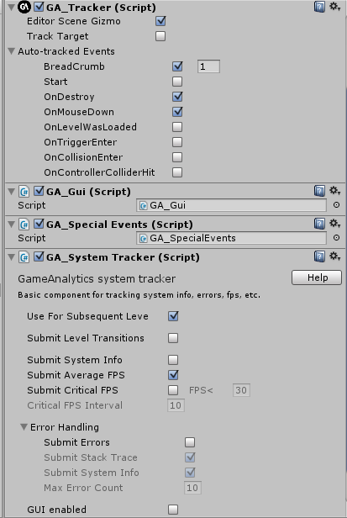
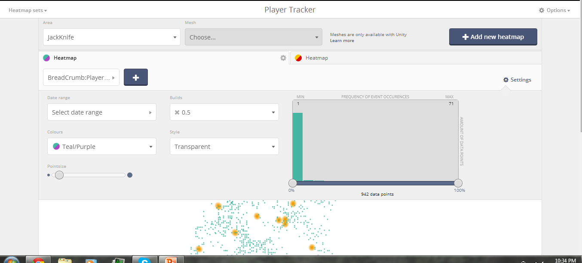
Game Analytics Tools Used
Online Heatmaps
GA_Tracker

Slide 32
Conclusion
I now know how to use the Game Analytics Unity tools, and all of the unique elements that they can track.
I learned a lot about testing and experimenting with different options and difficulties.
I also learned about player movement, decision making, and rationale.

